Slide 1

Introduction to basic c++
Alexandra Miller

Slide 2

Classes
We create a shelter.cpp class
We have the function set up as
Return_type name(argument_type arg_name){
//inside of your function
}
When creating a class we will also need #include <>

Slide 3
Functions
We create functions that will be used by main or other functions used in main.
We can create functions like
Add Dog
Remove Dog
Read dog list
List current dogs

Slide 4
Dog class
Now that we have a main class we are going to want to make an object.
Lets think of the main class as what we do to the dogs, but we need to first create some dogs.
We can do this by making a dog class

Slide 5
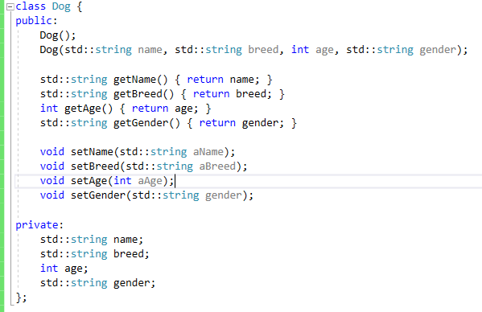
Dog.h
Here is our basic dog class.
We can create this class easily by making 4 different groups
Needed object functions
Getters
Setters
privates

Slide 6
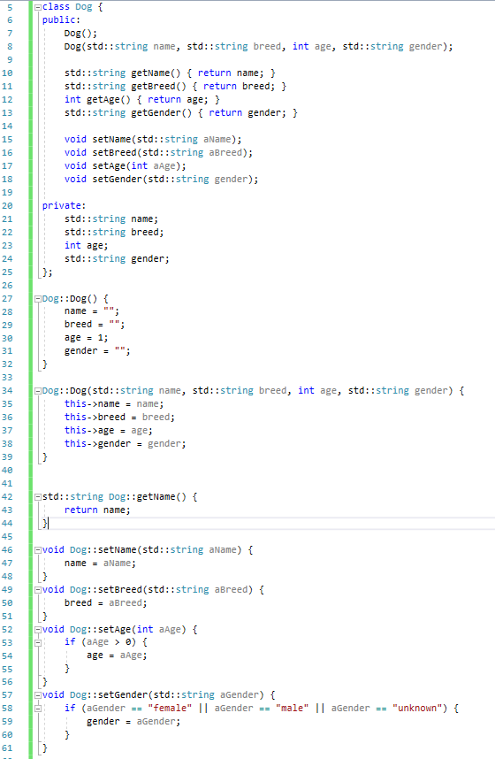
Implementing them
You can easily implement and make the other objects inside of your dog.h file below the class.
If your function is a quick return and you know what it is already you can just add the return in the class or make another function (either line 10 or lines 42-44)
We need to have get functions so we don’t directly give away our information. If we didn’t have this someone could do: pup.age = -100 (This makes no sense)
We also have setters so we can ensure that they only put information we want and that’s correct

Slide 7
Thinking of data structures
Now we have our dogs and we can create as many dogs as we want and now we need a way to hold all of the dogs
How can we hold a list of dogs? We have multiple options for data structures
We need to look at them all and decide which one would be the best for what we want to do

Slide 8
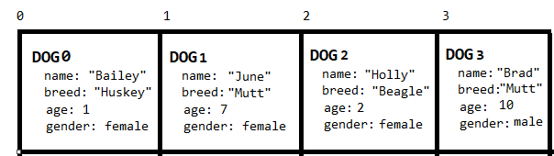
Arrays
This structure holds a given amount of space (that can’t be changed). It can hold any data type.
We can remove dogs, but we can only add dogs until we reach our limit we decided prior
This is good if we know we only have 15 kennels

Slide 9
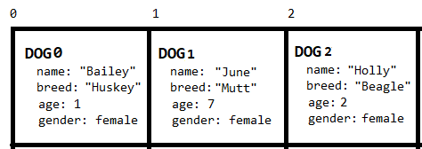
Vectors
Similar to Arrays except we can change the size whenever we want. We can also remove and add objects to the it much faster
This is after using pop_back
We have a lot of functions that make vectors easy to use

Slide 10
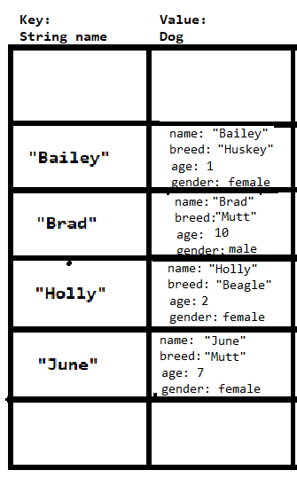
maps
This structure holds two parts, a key and a value
The keys are always sorted so its fast to find a key
This would be good to use if we wanted to print our list of dogs in alphabetical order
This takes up more storage, but if faster

Slide 11
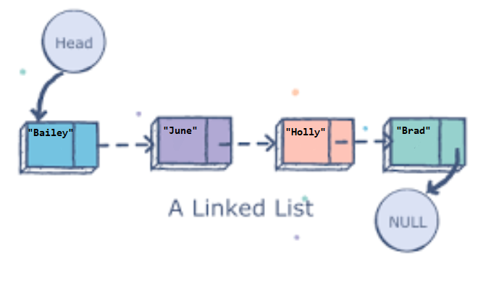
Linked list
Easy to remove and add dogs
Have to iterate through instead of indexing
Holds as many objects as you want

Slide 12
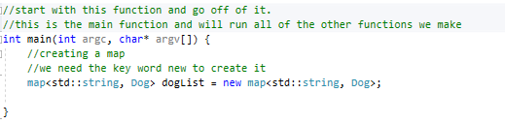
Choosing our data type
Lets go with a map so we can easily print out our list of dogs in alphabetical order

Slide 13
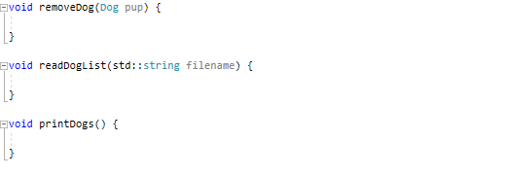
Want to make some functions
Lets create the functions we said we needed earlier for this
Add Dog
Remove Dog
Read dog list
List current dogs
Since we have a map we don’t need to create an add dog or remove dog function

Slide 14
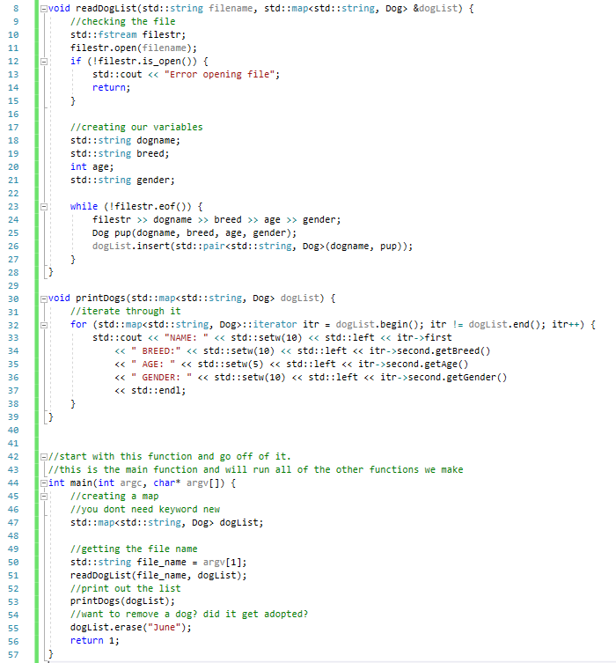
Filling in the functions
We did the readDogList and printDogs()
We were able to do this much faster than if we used another data structure

Slide 15
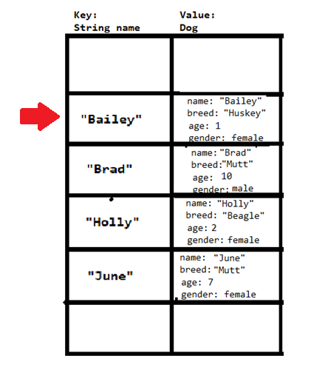
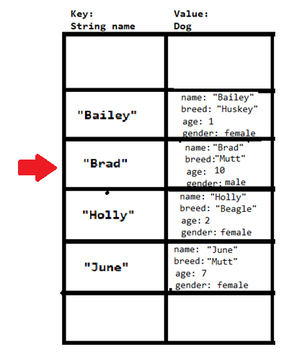
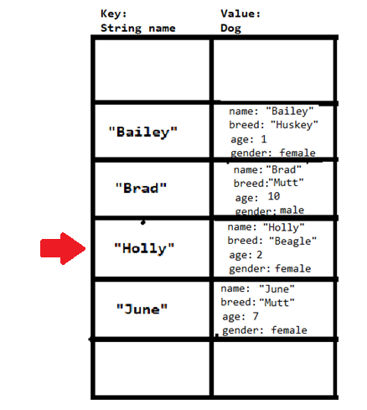
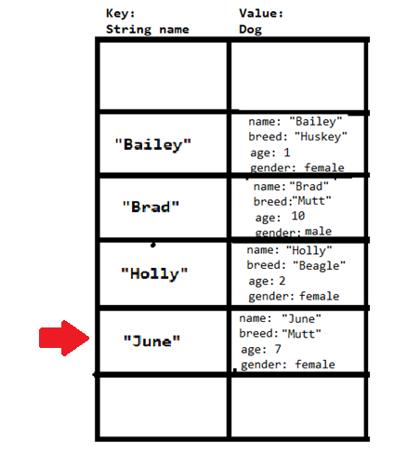
iterators

Slide 16
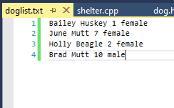

What our terminal is going to look like/how to compile

Slide 17
Thinking of how to make this more useful
What if we want to store all of this information into a text file then every time a dog gets adopted, we want to change and update the list
We would have to create more arguments
Create or update

Slide 18
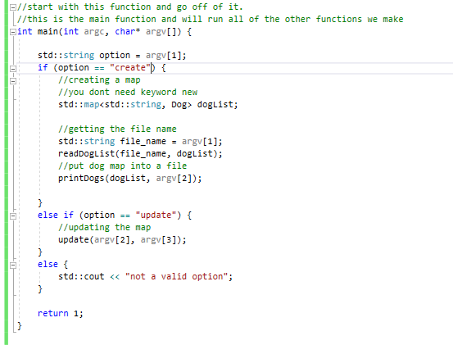
Updating the main to take in different options
We create an if else statement and see if we are just creating a new list of updating one
We also wan to check for user error so we make an else statement incase they put like “pie”

Slide 19
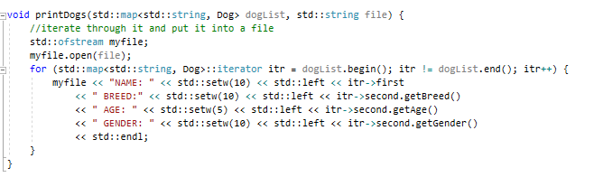
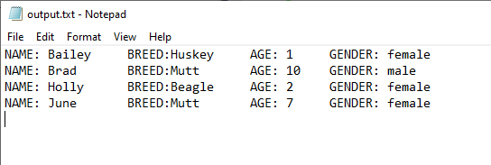
Making the create option print the data into a file

Slide 20
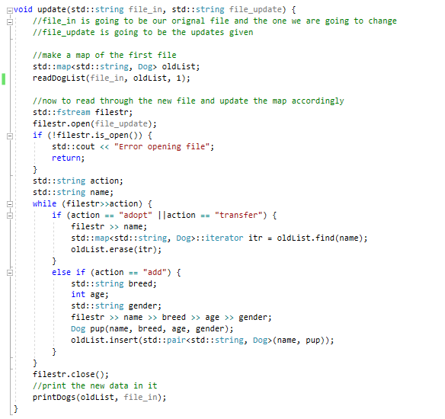
Now making the update function
We can use our other functions to make this faster and easier for us

Slide 21
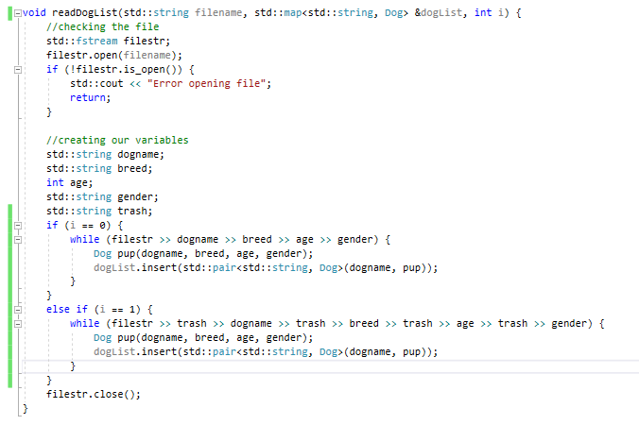
Fixing other functions to work with our new needs

Slide 22
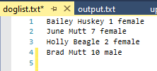
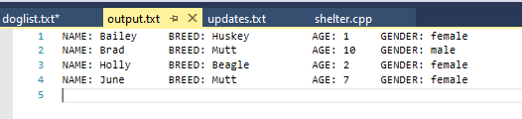
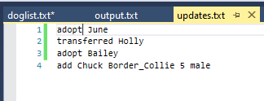
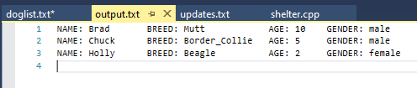
Input/output final

